Slide 1


PRESENTATION ON BIKE SHARING DEMAND DATASET
By - MD ANAS PATEL

Slide 2
OBJECTIVE
Primary Objective:
To build a superior statistical model to predict the number of bicycles that can be rented with availability of data.
Secondary Objectives:
1)To learn how real time data is represented in datasets.
2]To understand how to pre-process such data.
3)To study comparison of results achieved by various Machine Learning techniques such as Regression, Decision Trees.

Slide 3

About the dataset
This dataset contains the hourly and daily count of rental bikes between the years 2011 and 2012 in the Capital bike share system with the corresponding weather and seasonal information.
The training set is comprised of the first 19 days of each month, while the 1st set is the 20th to the end of the month of year 2011 and 2012.
Data Consist Of: 17415 observations of 10 variables.

Slide 4
Proposed methodology
Fetch and Analyze the Data
Pre processing
Clean Data
Remove Missing Data
Partition Data
Create New Features
Building a Prediction Model
Validate The Model
Predict Values For Test Data
Correlation

Slide 5
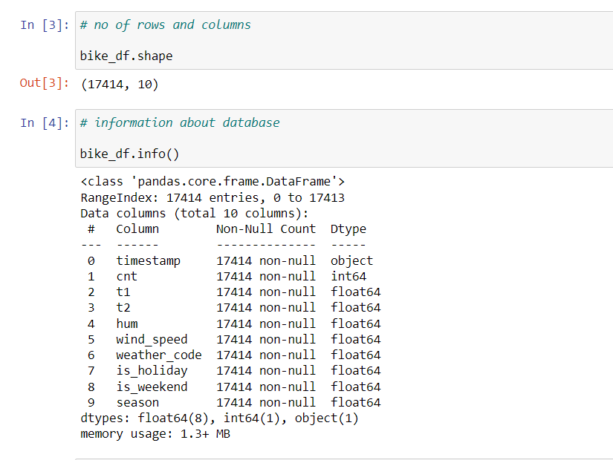
Exploring the data

Slide 6
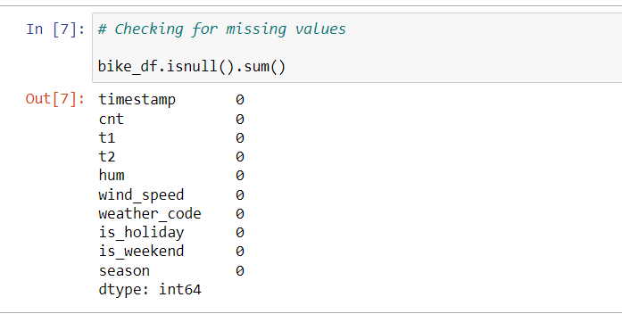
Checking missing values

Slide 7
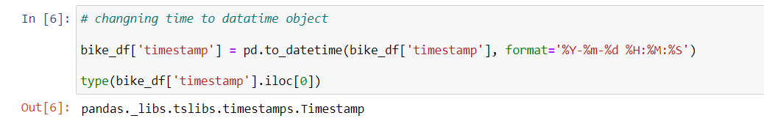
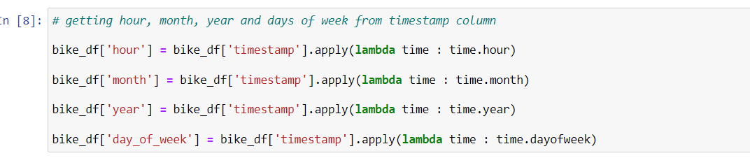
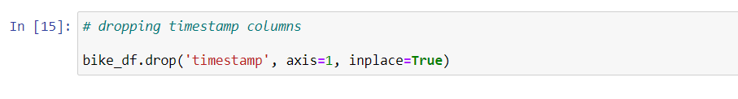
Pre processing changing timestamp into datetime object

Slide 8
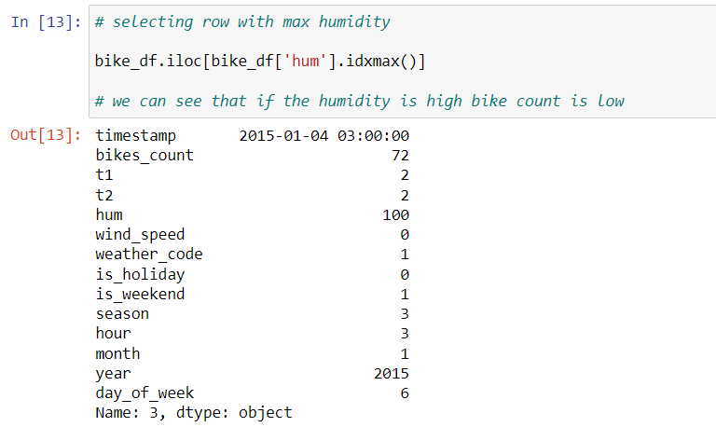
Selecting row with max humidity

Slide 9
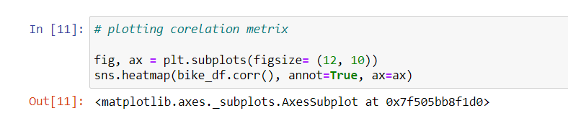
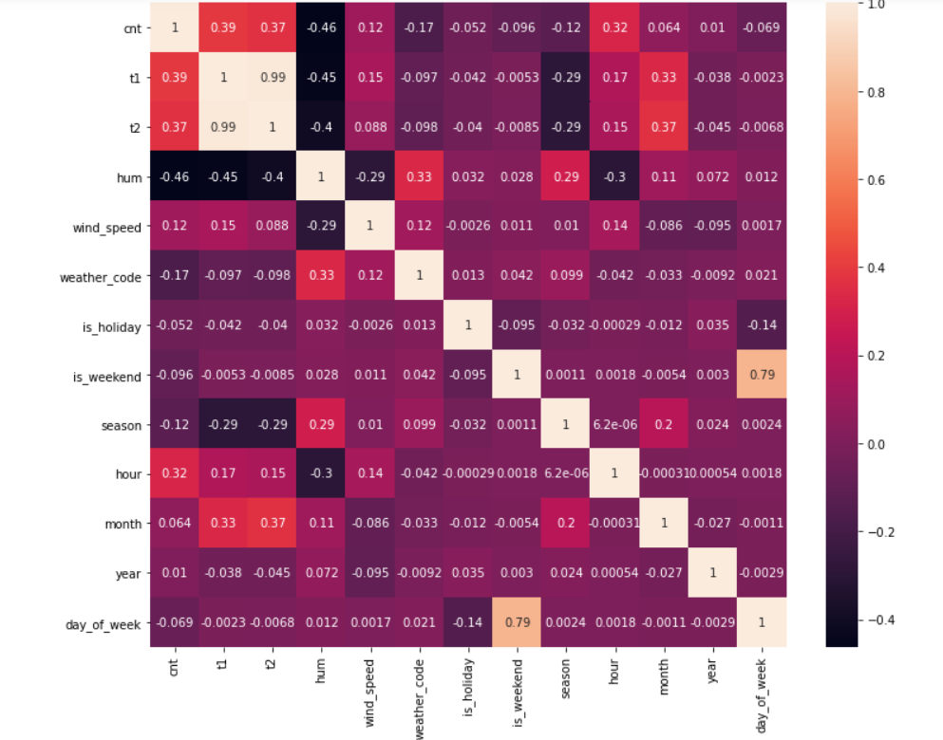
correlation

Slide 10
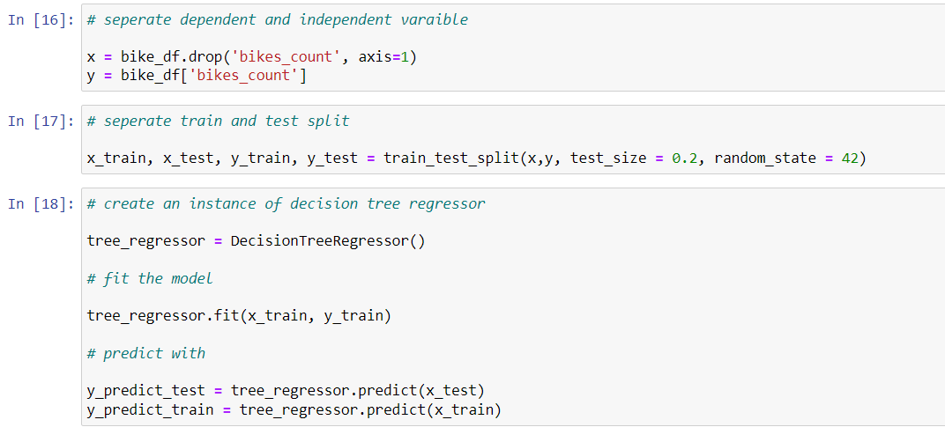
Model building

Slide 11
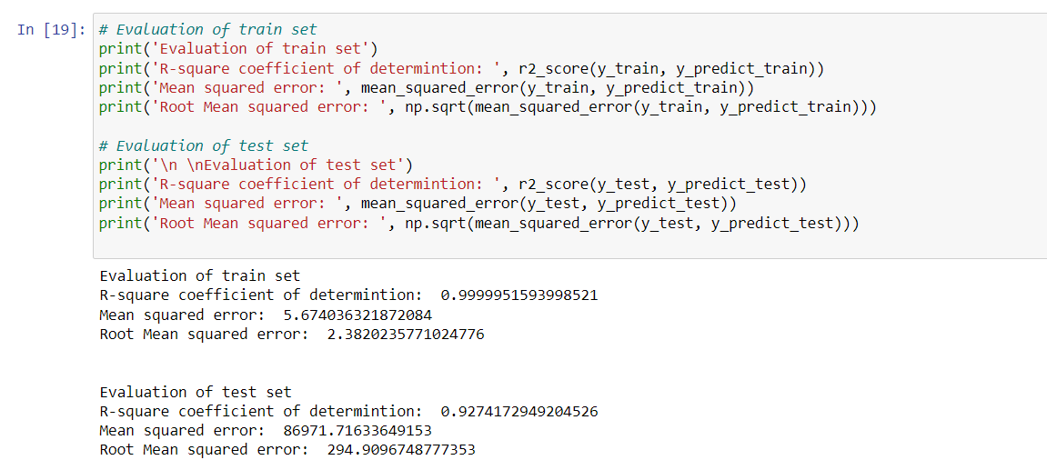
Model evaluation

Slide 12
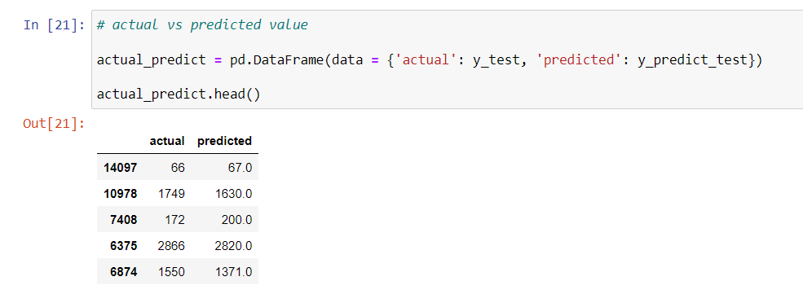
Actual vs predicted values

Slide 13
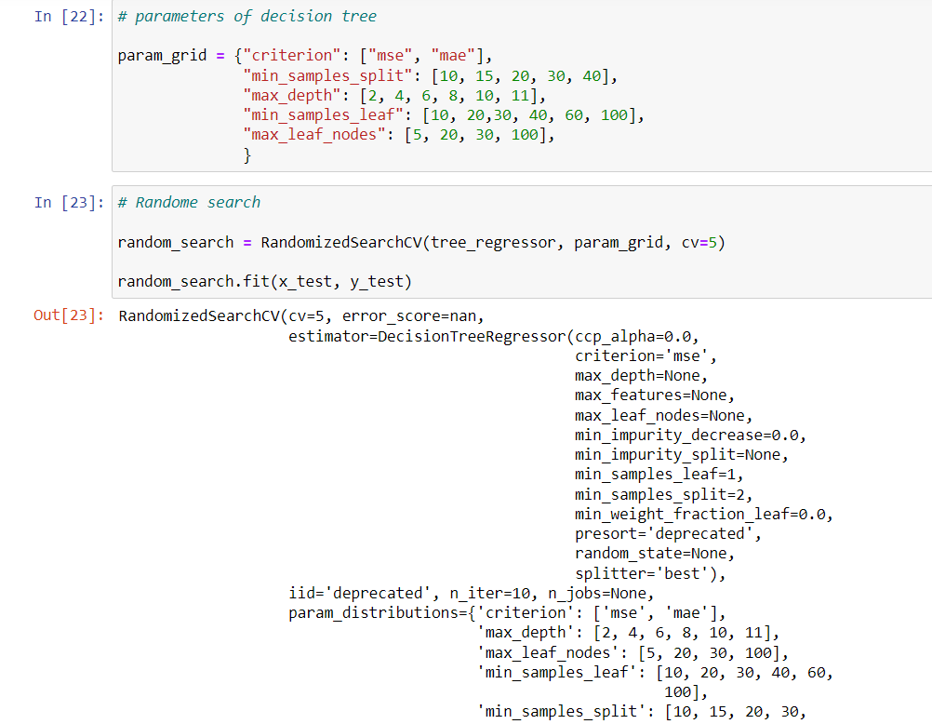
Hyper parameter tuning

Slide 14
Thank you

